Slide 1

Towards a Life Events Service Gov Digital Wallet Update – Feb 2024
Tony Shannon
Head of Digital Services
Office of Government Chief Information Officer
Department of Public Expenditure, NDP Delivery and Reform

Slide 2


Slide 3

Stories from the Frontline

Slide 4


Digital & Data – at the Frontline

Slide 5
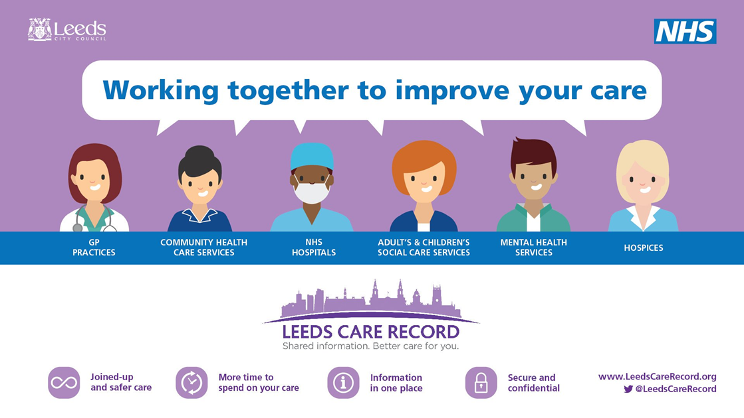
Stories from the Frontline

Slide 6

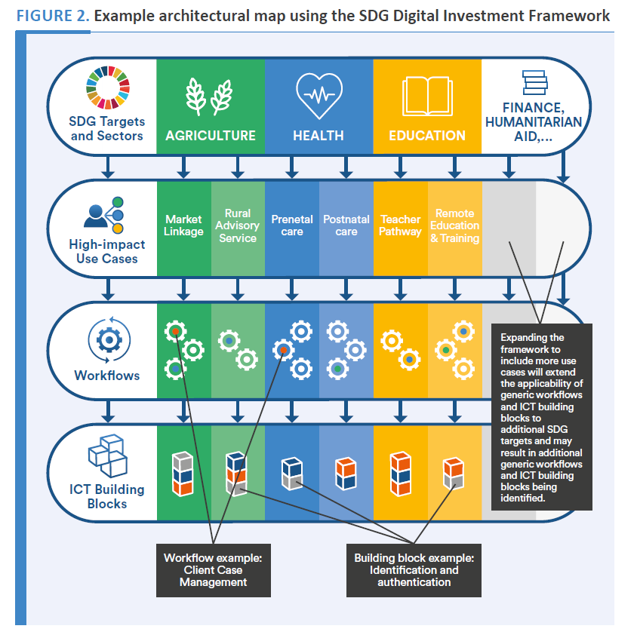
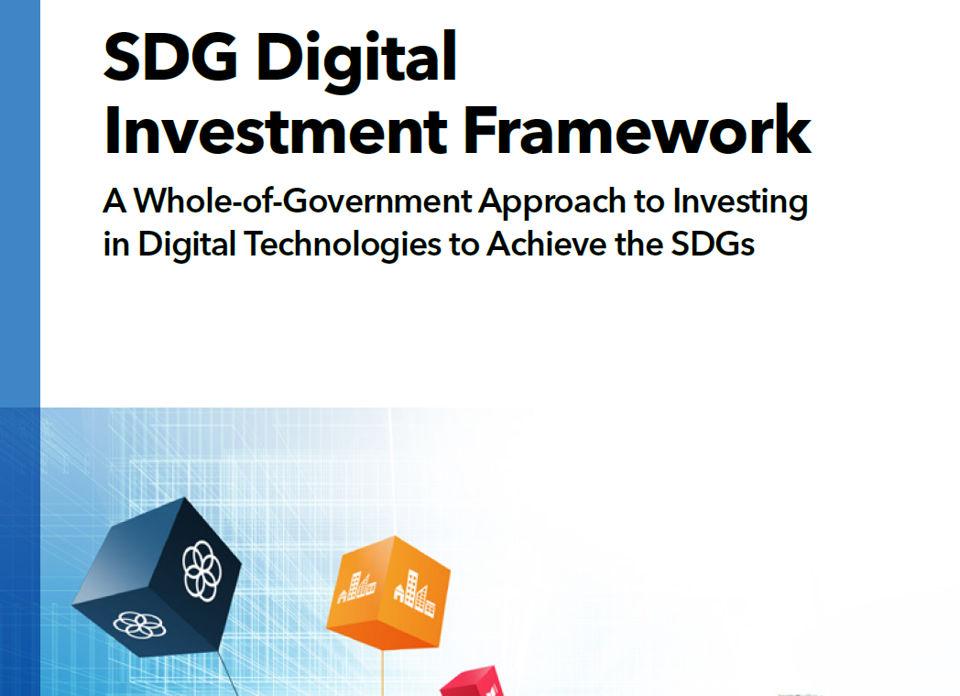

Slide 7
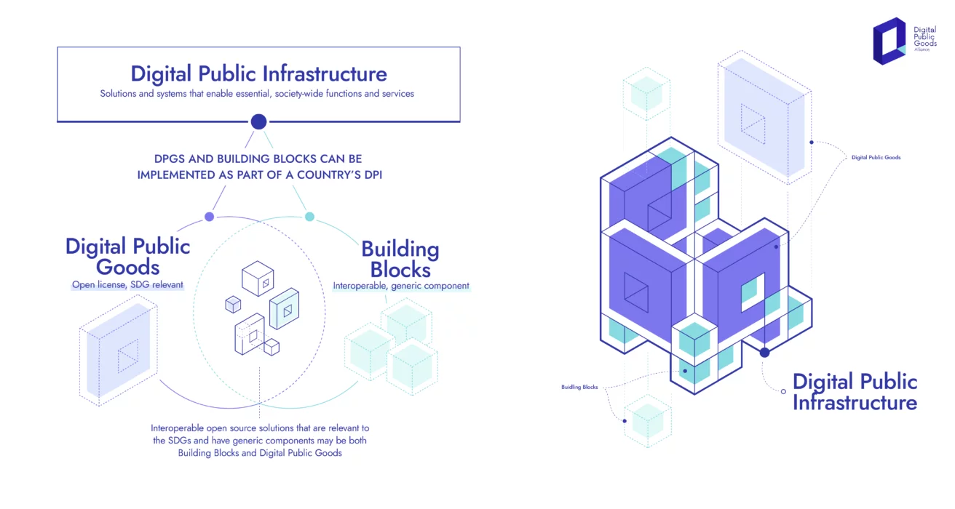
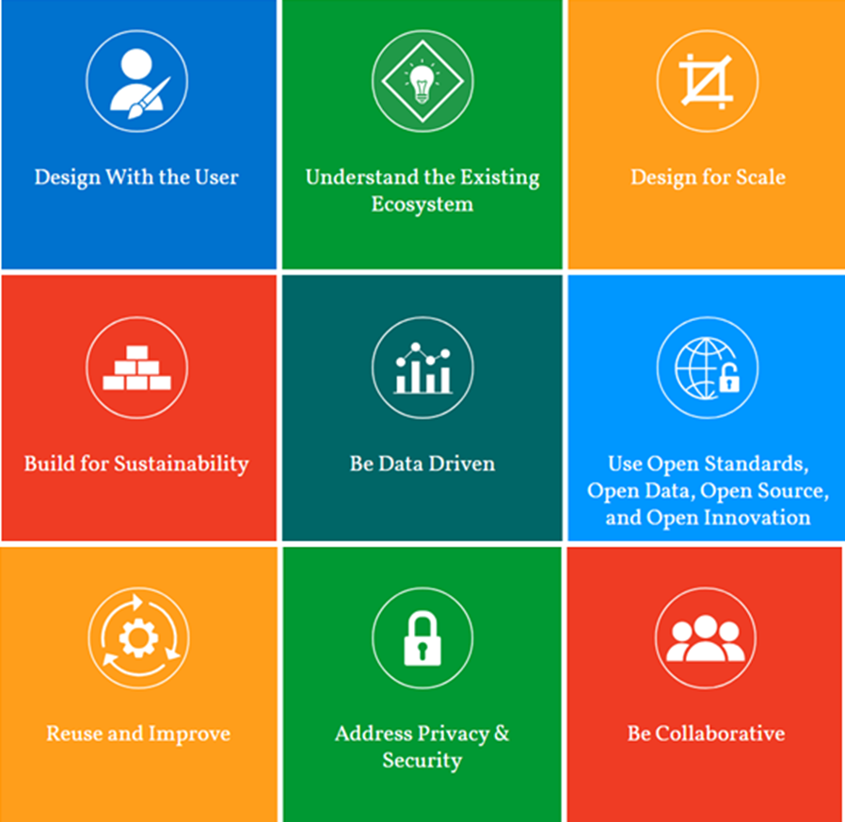
Towards a Digital/Data Commons

Slide 9

What?

Slide 10

Why?

Slide 11
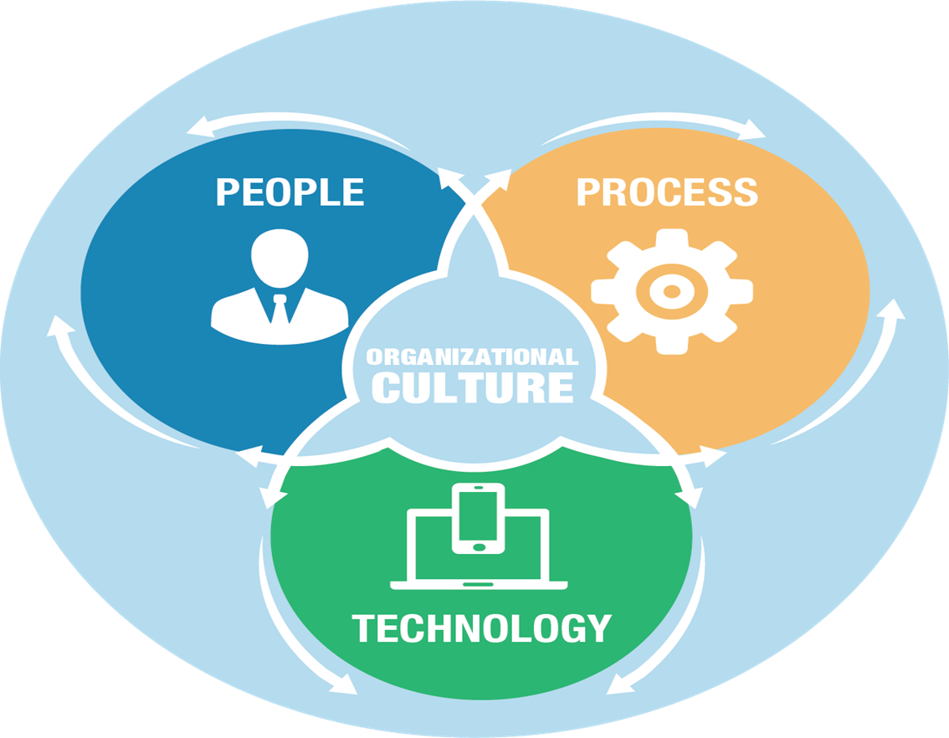
How?

Slide 13


Digital and Innovation at Scale
The Public Service will work together to
Tackle big societal issues and drive societal change
Achieve a seamless user experience and inclusive service delivery
Provide a dynamic and agile workplace
A Public Service that:
Builds trust in public institutions
Focuses on outcomes
Delivers climate action and sustainability

Slide 14
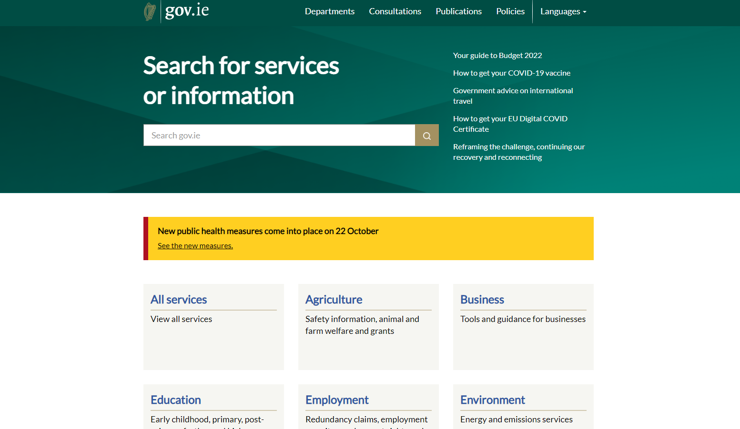
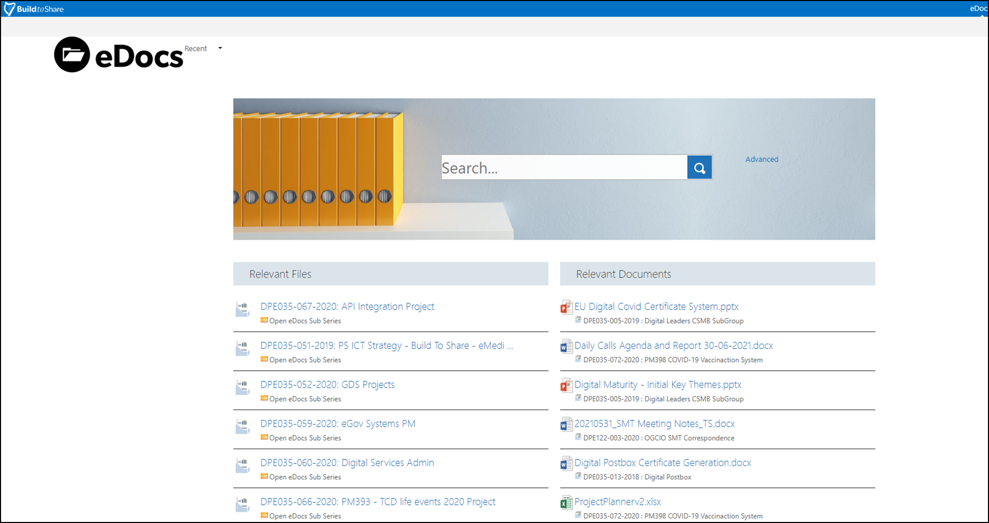

Slide 15
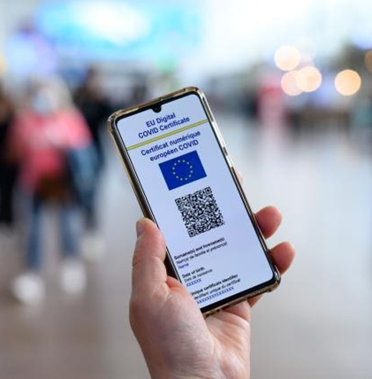
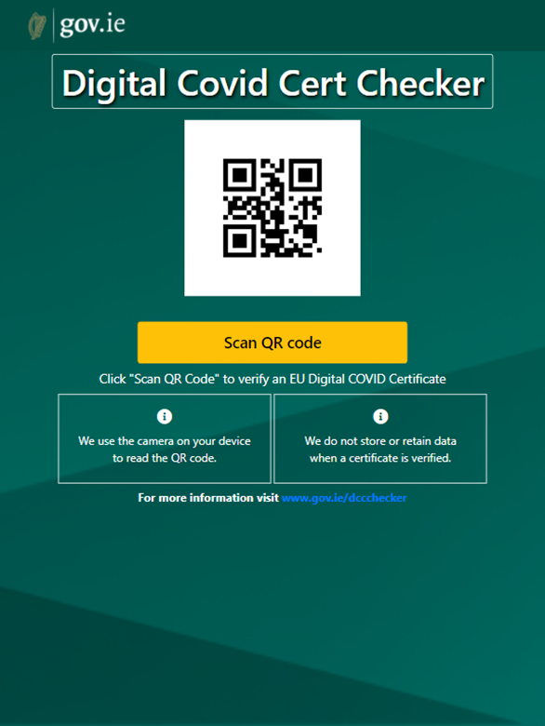

Slide 16









Life Events
Life events refer to significant experiences or changes in an individual's life that can have a profound impact on their circumstances and/or well-being. These events often necessitate interactions with multiple services or agencies
Renting, Buying,
Moving House
Having a baby &
early childhood
Owning &
Driving a Car
Setting up a
Business
Finding &
losing a job
Moving to
Ireland
Marriage/
Divorce
End
of life

Slide 17



Life Events
Service Design & Co-Creation

Slide 18

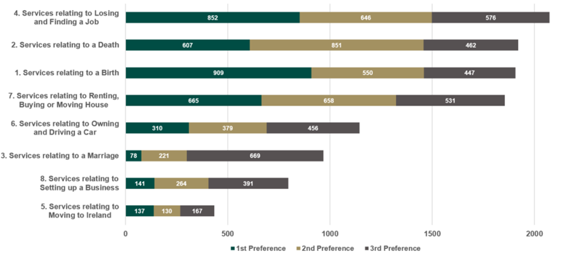
Life Events – Public Response
Sorted using 1st to 3rd Preference Totals*

Slide 19
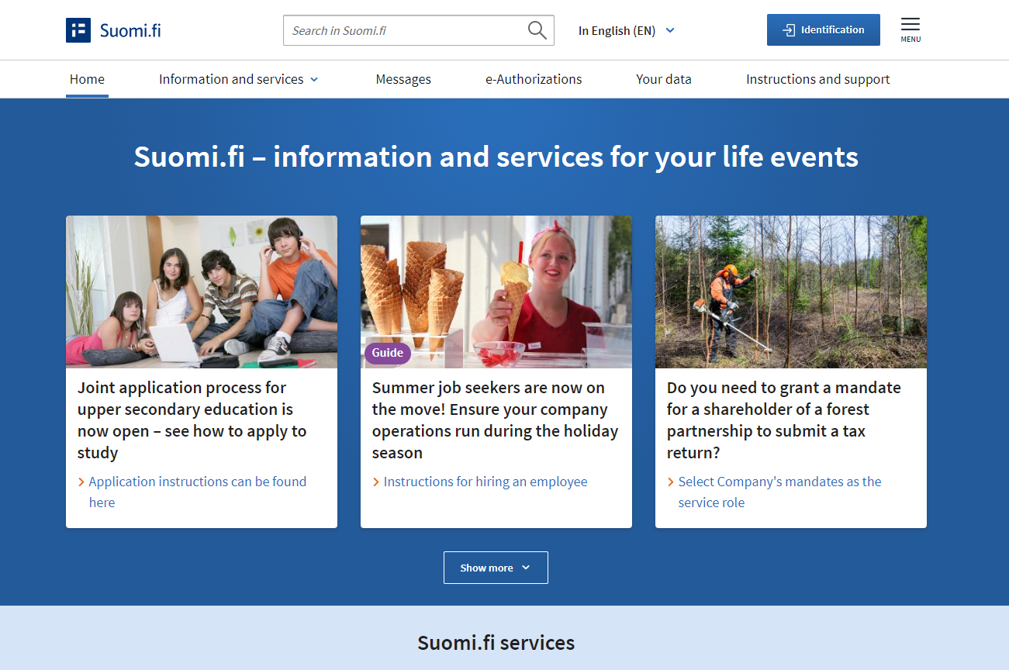
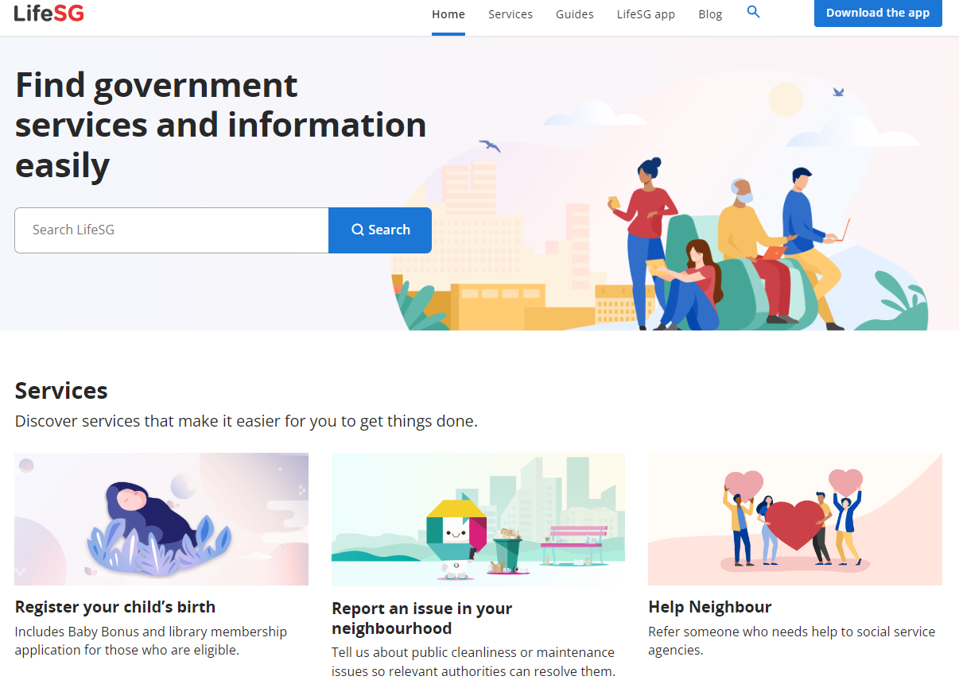

Slide 21

People - User Centred Design

Slide 22


10 Design Principles for Government
in Ireland
We will put
people first
We will design services together
We will design so knowledge can be reused
& shared
Principle 01/
Principle 03/
Principle 05/
We will design
to be inclusive
We will design for trust
Principle 02/
Principle 04/
We will challenge assumptions
& design
with evidence
We will design to deliver value - in all its forms
We will work
to make
things simpler
Principle 06/
Principle 08/
Principle 10/
We will design from the top down & the bottom up
We will build, test, learn & iterate
Principle 07/
Principle 09/

Slide 23
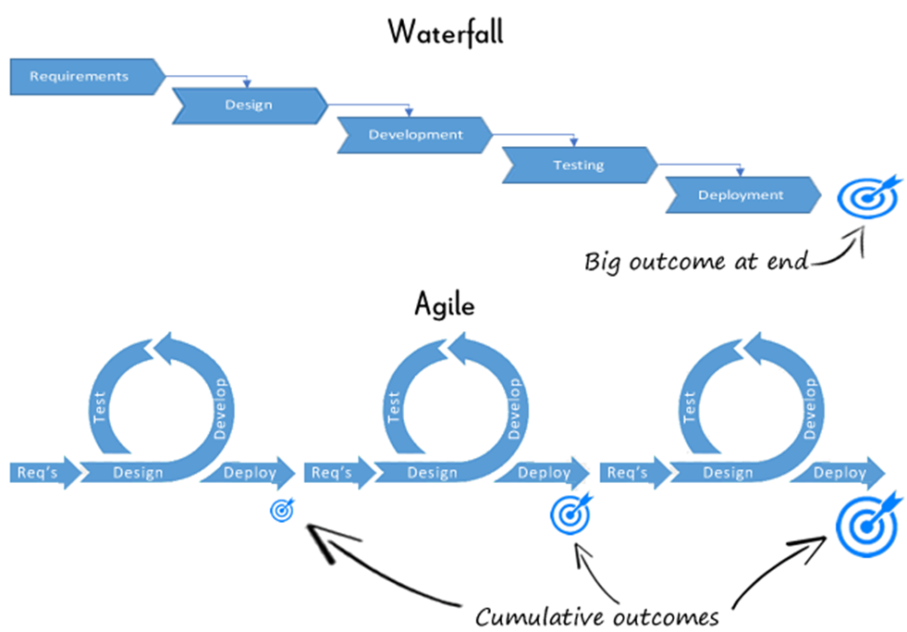
Process- Agile & Iterative
People - User Centred Design

Slide 24



Technology – Building Blocks- Open

Slide 25


Life Events Service / Once Only Principle
Digital Identity
Content Management
Data Collection- eforms
Case Management - eCase
Messaging
Credential-Wallet
Information Mediator

Slide 26
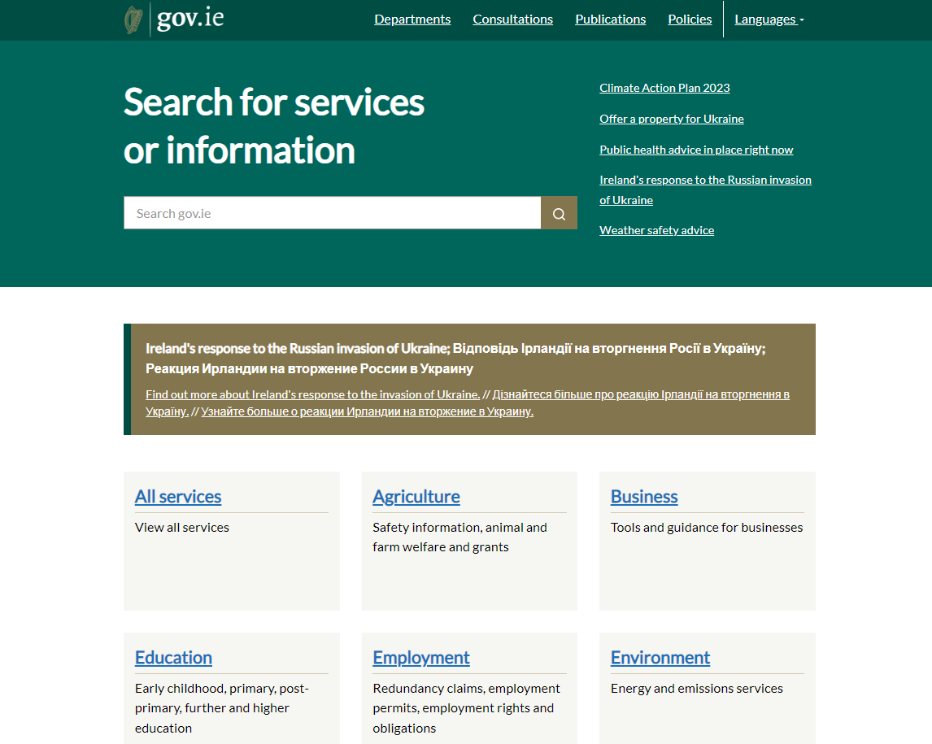
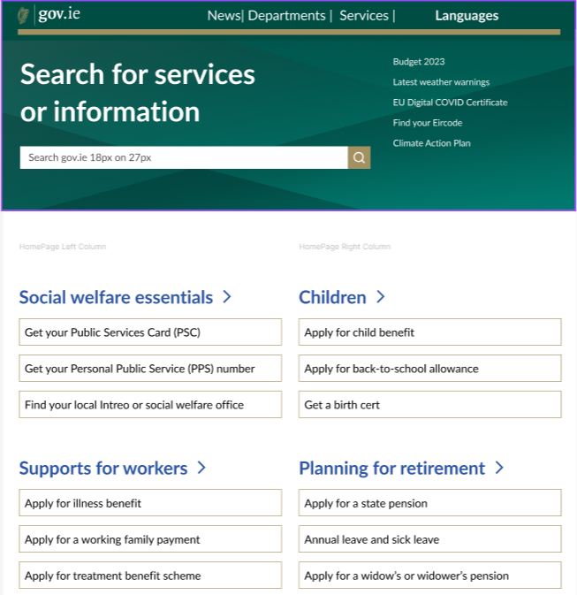

Slide 27
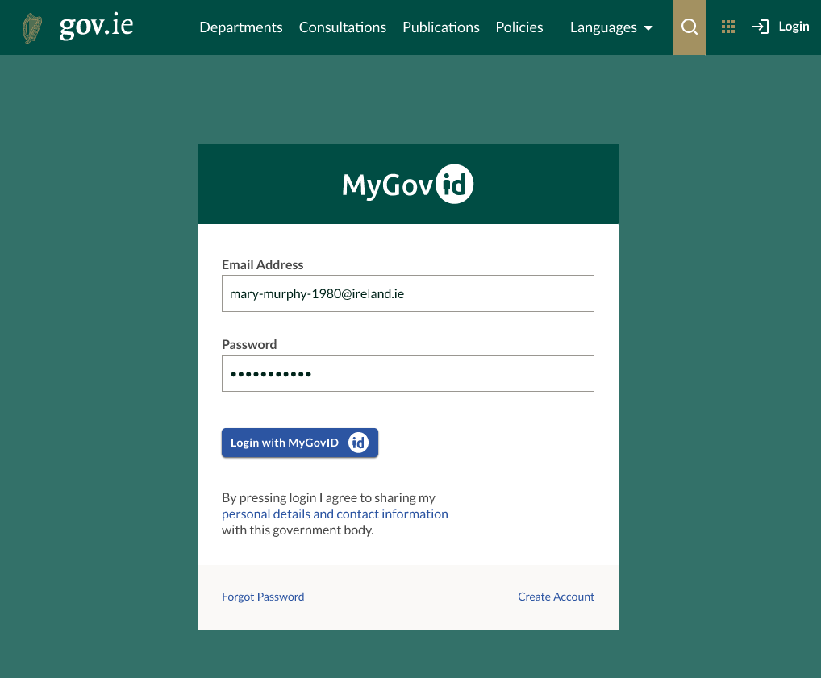

Slide 28
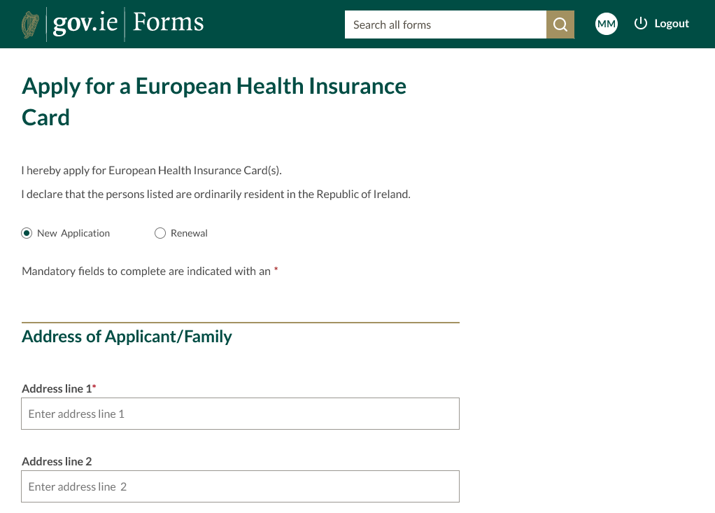

Slide 29
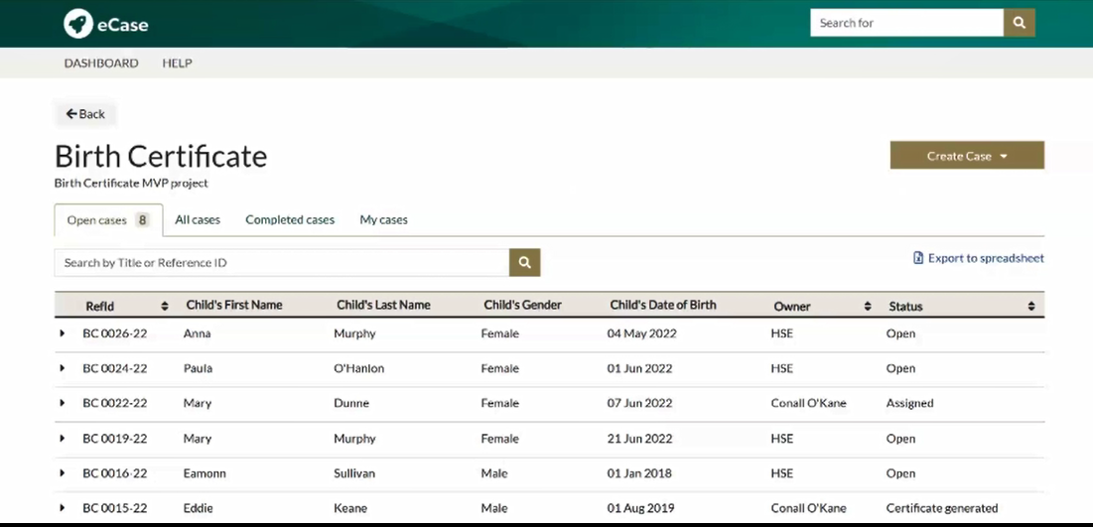

Slide 30
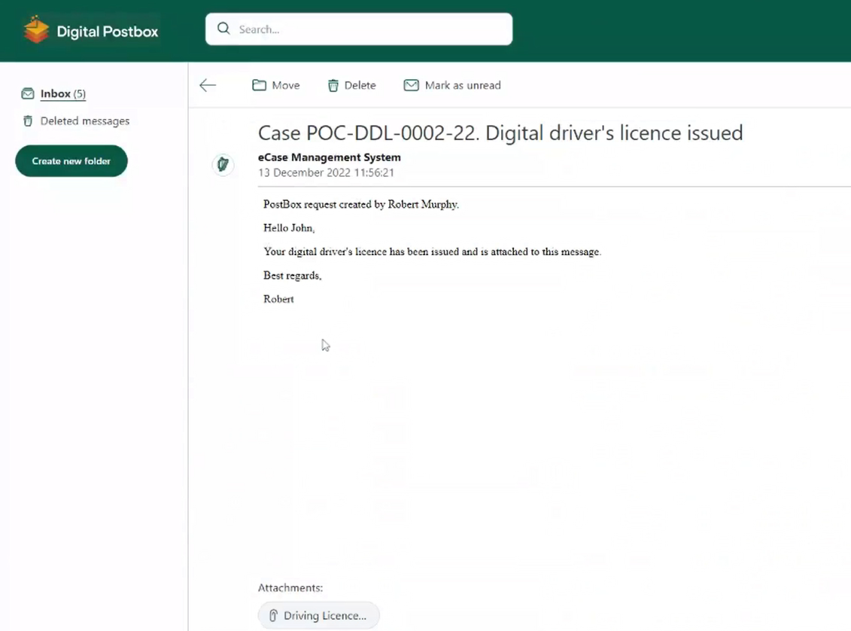
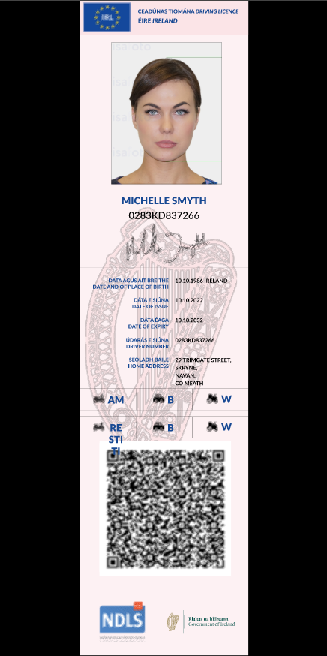

Slide 31
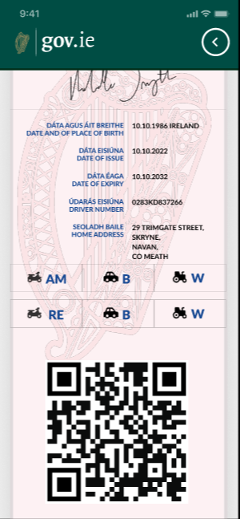
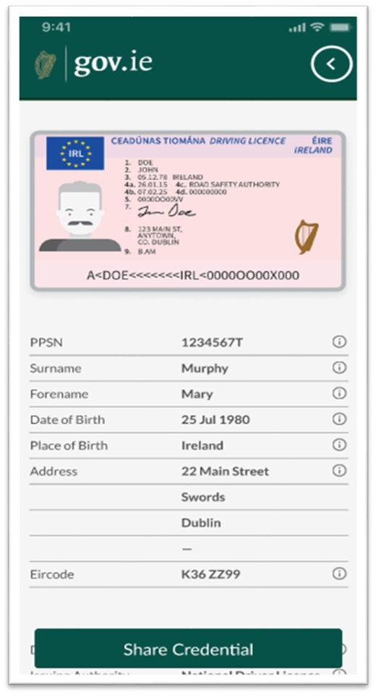
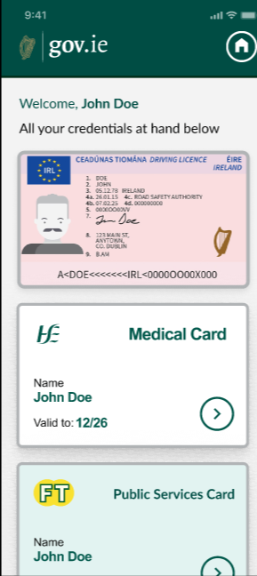
Digital Wallet- Credentials - Data

Slide 32
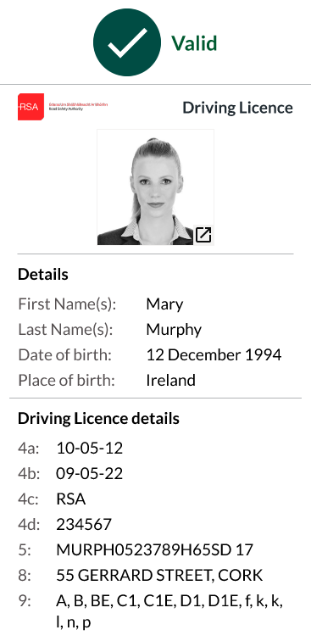
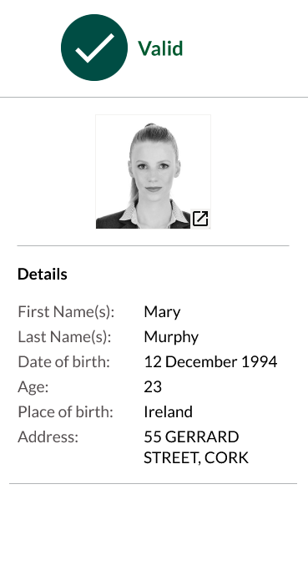
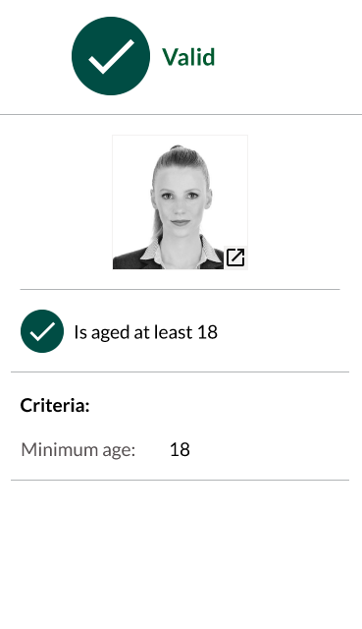
Data & Selective Disclosure

Slide 33
Dig Wallet – Data Sharing & Third Parties
Life Events to Digital Wallet - Gov/Public Sector/National Level - Mockup
https://www.figma.com/proto/fLBdoyqpbXLCheeikYRNXE/Digital-Wallet---Gov.ie---POC?page-id=249%3A11712&type=design&node-id=296-27100&viewport=8821%2C2497%2C0.25&t=Bc0Vznia2Q7MTsTv-1&scaling=min-zoom&starting-point-node-id=296%3A27100
Life Events to Digital Wallet - Gov/Public Sector to citizen share to EU/Private Sector - Mockup
https://www.figma.com/proto/fLBdoyqpbXLCheeikYRNXE/Digital-Wallet---Gov.ie---POC?page-id=293%3A26847&type=design&node-id=296-26771&viewport=15358%2C4560%2C0.5&t=EBmEDX8XqD17nf9M-1&scaling=min-zoom&starting-point-node-id=293%3A27488&show-proto-sidebar=1

Slide 35
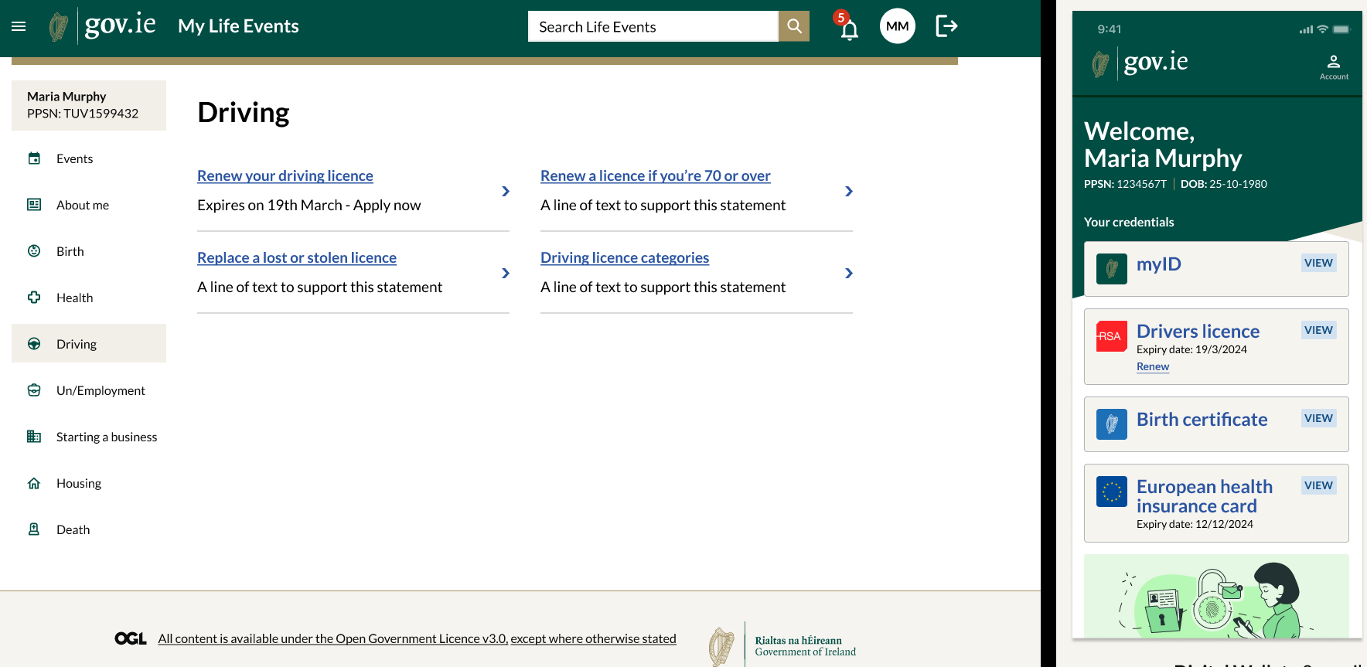

Slide 36
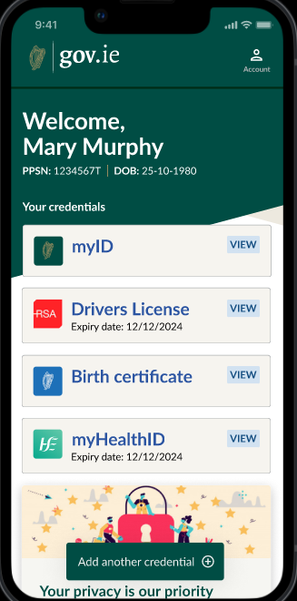
Government Digital Wallet Pilot: Scope
Launch to approx. 50 volunteers prior to the Christmas break
Volunteers will log in to a gov.ie app using their MyGovID
A myID credential will be created and stored in the wallet
Digital Driving Licence, Birth Cert and EHIC available
Key credentials can be accessed and stored in this wallet
Validator app will confirm validity of valid credentials
This pilot will run for 12-15 weeks
Pilot will extend to wider public service & public across 2024
Base functionality will be improved & enhanced thereafter
EHIC

Slide 37

Challenge?

Slide 38

Opportunity

